Slide 1



Spring Cloud Audience: All

Slide 2
Introduction
Spring Cloud
Who I am: <Instructor Name>
Title
Organization
Role
Background

Slide 3
Agenda
Spring Cloud
Microservices – History, Driving Forces, and Definition
Microservices Patterns
DevOps
Reactive Microservices
1
5
9
13
AD
All
D
AD
A
Microservices Prerequisites
Integration
Securing Microservices
Testing
2
6
10
14
AD
AD
A
D
A
A
Spring Boot
Migrating Monoliths to Microservices
Domain Driven Design Testing
Scaling Microservices
3
7
11
15
AD
D
A
A
A
Case Study
Cloud
UI
Microservices Anti-Patterns
4
8
12
16
AD
AD
All
All
A
A
Legend: All Developer Advanced Developer Architect
All
D
AD
A

Slide 4

Objectives
Spring Cloud
At the end of this training, you should be able to:
Understand the concepts of Spring Cloud

Slide 5
Topics
Spring Cloud
Spring Framework
Spring Cloud Umbrella
Netflix OSS

Slide 6

Spring Cloud Addressing issues found in Cloud Native applications Spring/Spring IO/Spring Cloud
Notes:
First I'll begin by providing a little background on the project origins.
Then I'll explain a little bit about Netflix Open Source Software
And finally I’ll guide you through a brief set of topics that we'll want to cover before moving on.
For this next section of the course, I'd like to focus on Spring Cloud. There is a lot to cover, so I'd first like to set the landscape of what Spring Cloud is, what it is for, and why it is instrumental to building microservices and cloud-native applications.

Slide 7
















Spring Cloud Origins
Spring Cloud
First, there was the Spring Framework (2004)
Alternative to low-level JEE approaches
Next, Spring sub-projects emerged (2006 - present)
Spring Security, Web Flow, Integration, Batch, Web Services, XD, Social, Data, Boot, Session, and so on
Organized under Spring IO umbrella:
Reactor
Android
Mobile
Security
Spring
Framework
Batch
Integration
Web Flow
Social
Data
Web Services
Boot
AMQP
HATEOAS
Cloud
Notes:
Spring Cloud is one of the Spring IO projects. So let me explain what that means.
First, back in 2004, the 1.0 version of the Spring Framework was released – presently we are on 5.0. The goal of the Spring Framework was to provide a simple, productive, well architected substitute for some of the APIs that were coming from the J2EE world at that time. Its been highly successful and most organizations use it, at least to some extent.
Now since the 2.0 version of the Spring Framework, we've seen a number of sub-projects spawned; things like Spring Security, Web Flow, Spring Integration, and the others that you see listed here. What has really developed is a family of projects under the Spring umbrella; these projects are not part of the “core” Spring Framework, but they follow the same principles and are easy to adopt. In fact I'd say that for the last 5 years, most of the innovation has not come out of the Spring Framework itself, but the sub-projects it has spawned.
Back in 2014 the term “Spring IO” was coined to better explain this family of projects. Spring Framework is the centerpiece, but there has been an explosion of really fantastic sub-projects that are focused on specific areas. The illustration you see here is only a partial list of the projects, and it seems that every few months there is a new addition.

Slide 8
Spring Cloud Subproject
Spring Cloud
“Sub-Umbrella” Project within Spring IO Platform
Reactor
Android
Mobile
Security
Spring
Framework
Batch
Integration
Web Flow
Social
Data
Web Services
Boot
AMQP
HATEOAS
Spring Cloud Config
Spring Cloud Netflix
Eureka
Hystrix
Zuul
Ribbon
Feign
Spring Cloud Bus
Notes:
Spring Cloud is a sub-project within the Spring IO umbrella. And yet, it is actually several separate projects itself, so it is actually an umbrella within an umbrella.
In the next few sections of this course we will go through Spring Cloud Config, Netflix Eureka, Hystrix, Ribbon, Feign, and Spring Cloud Bus. There are other areas of Spring Cloud that this course will not address, such as Spring Cloud Connectors and Spring Cloud for Amazon Web Services.
The connectors project is a useful adapter when running on Cloud Foundry or Heroku, and the AWS project is useful if you need to deal with AWS at the API level. But we won't need to go into either of these areas.

Slide 9
What Spring Cloud is not?
Spring Cloud
Spring Cloud is NOT some hosted environment somewhere!
Notes:
Now just to be clear, please understand that Spring Cloud is NOT some hosted environment like AWS or Azure or Google Cloud or anything else.
It is a set of libraries to help you build cloud-native applications.

Slide 10

Goal of Spring Cloud
Spring Cloud
The goal of Spring Cloud is to provide libraries to apply common patterns needed in distributed applications as follows:
Distributed/Versioned/Centralized Configuration Management
Service Registration and Discovery
Load Balancing
Service-to-service Calls
Circuit Breakers
Routing
Notes:
So what is the Goal of Spring Cloud?
The goal of Spring Cloud is to address the needs of Cloud Based applications. Cloud Based applications are basically distributed applications running in an environment best characterized as “volatile”, and as such there are some common patterns that are needed to address the reality of the platform.
Throughout this course we will go through the patterns listed here and I will explain what the issues are, how the patterns address the issues, and how you can apply Spring Cloud to implement a solution.

Slide 11

Spring Cloud Netflix
Notes:
Now a moment ago I mentioned something about Netflix – let's circle back and explain that part a bit more fully.

Slide 12
Goal of Spring Cloud
Spring Cloud
The goal of Spring Cloud is to provide libraries to apply common patterns needed in distributed applications as follows:
Distributed/Versioned/Centralized Configuration Management
Service Registration and Discovery
Load Balancing
Service-to-service Calls
Circuit Breakers
Routing

Slide 13
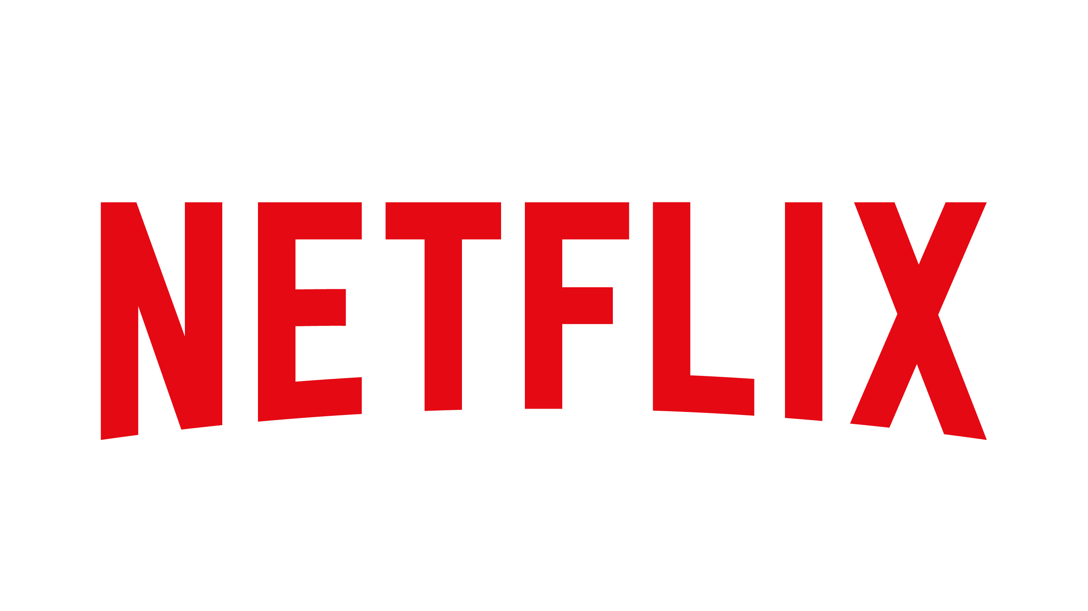
Where does Netflix fit into all of this?
Spring Cloud
Netflix reinvented itself since early 2007
Moved from DVD mailing to video-on-demand
Once USPS largest first-class customer
Now biggest source of North American internet traffic in evenings
Became Trailblazers in Cloud Computing
All running on Amazon Web Services
Chose to publish many general-use technologies as Open-Source projects
Proprietary video-streaming technologies are still secret
Notes:
So Where does Netflix fit into all of this?
Netflix is the video streaming company that you are thinking about. Back in 2007 they quite famously re-invented their entire business. They had conquered the DVD mailing business, but could see that it would be eventually be supplanted by video streaming over the internet. So they chose to innovate at a time when the viability of video streaming was far from assured.
Consequently, they became pioneers in the Cloud Computing technologies, doing things that no one had done before. Rather than build their own massive infrastructure, they chose to utilize Amazon Web Services, since AWS already had affordable, globally distributed compute and storage capability. However, AWS didn't really address the software component – no one did. So Netflix had to invent the technologies needed to deliver a world class cloud-based business. One of the things I find interesting about this story is that the innovations and software did not come from the traditional IT companies like Oracle, Microsoft, IBM, HP and others, but from the people doing the actual work.
Netflix decided that many of their innovations were useful, general purpose systems that could be used for a wide variety of purposes. So they decided to Open Source these technologies to allow the benefit to pass to others.

Slide 14

Spring and Netflix
Spring Cloud
The Spring team has always been forward looking
Trying to focus on applications of tomorrow
Netflix OSS mature and battle-tested; why reinvent?
Netflix OSS not necessarily easy and convenient
Spring Cloud provides easy interaction:
Dependencies
Annotations
Notes:
The Spring Team has always had a forward-looking focus, and had been very interested in addressing the needs of microservice-style applications needing to run in a Cloud environment.
The team was quick to discover that the Netflix OSS projects had addressed a number of the key architectural items required in a cloud environment. And these were not theoretical needs; these were actual needs solved by developers on the front-line of business that needed to conquer cloud based applications. And the quality and forethought was excellent, so why re-invent something else?
But there was a need to improve the consumability of the Netflix projects; after all, Netflix developed these projects for their own needs and were not strongly motivated to make them easily consumable. And this is exactly where the Spring Team came in, making it easy to consume the excellent work that had already been produced by the Netflix team.
As you will see in this course Spring Cloud provides very easy access to the Netflix libraries, in many cases all that is needed is a dependency and additional annotations.

Slide 15

Common Concepts
Notes:
So that is a high-level summary of what the Spring Cloud project is, where it fits, and where Netflix figures into all of this. Now before we jump into our first area there are some conceptual items that I want to make sure we address.

Slide 16

Spring Cloud Setup
Spring Cloud
Spring Cloud Projects are all based on Spring Boot:
Difficult to employ using only core Spring Framework
Dependency management based on Boot
ApplicationContext startup process modified
Notes:
For the rest of this course, you'll be seeing code examples – and actually building services – that are based on Spring Cloud.
The first thing to realize about the Spring Cloud libraries is that they are all intended to be used by Spring Boot applications. They are not intended to be utilized using just the Spring Framework – although it is possible it really isn't the intent. All of the dependency management – which there is quite a bit – is all based on Spring Boot. And most importantly, the startup process of the applications is usually altered slightly, and the ApplicationContext is not created in the same straightforward way as a normal Spring Framework based application.
I'll not go into the details here, it really isn't too important to grasp this. But I did want to qualify this from the very beginning. I've seen some people out on the forums confused on this point.

Slide 17

Server versus Client
Spring Cloud
‘Client’ and ‘Server’ are relative terms:
Based on the role in a relationship
Microservice is often a client and a server
Don't get lost on the terminology!
Notes:
The other thing I wanted to warn you about before we get too far into this course is that it is important to not get lost on the terms “client” and “server”. These are relative terms based on the relationship of who is calling whom, and very often one of our microservices is both a client and a server. This gets really tricky later when we start talking about Eureka, so just remember these are relative terms.

Slide 18
Required Dependencies
Spring Cloud
Spring Cloud projects are based on Spring Boot
BUT Spring Cloud projects have other dependencies
Designate Boot as Parent
<parent>
<groupId>org.springframework.boot</groupId>
<artifactId>spring-boot-starter-parent</artifactId>
<version>2.2.6.RELEASE</version>
</parent>
...
<dependencyManagement>
<dependencies>
<dependency>
<groupId>org.springframework.cloud</groupId>
<artifactId>spring-cloud-starter-parent</artifactId>
<version>Hoxton.SR3</version>
<type>pom</type>
<scope>import</scope>
</dependency>
</dependencies>
</dependencyManagement>
Watch for later versions...
Use “dependencyManagement”
for Spring Cloud dependencies.
Release Train
Notes:
Since all Spring Cloud Projects are first and foremost Spring Boot projects, you will want to setup your projects with the Spring Boot Starter Parent as the parent POM – this is true if you decide to use Gradle too. Now if your organization has decided to refer to the Boot Parent POM via your own parent POM, that's is fine too. Just make Boot the parent one way or another.
<ANIMATION>However, Spring Cloud projects will need to refer to dependencies that Spring Boot does not know about. To make this easy you can utilize what Maven calls a “dependency management” section. It allows you to reference a parent POM without actually making it the parent – kind of like multiple inheritance. This is the recommended way for setting up dependencies in a Spring Cloud application, though it wasn't when Spring Cloud was first introduced.
<ANIMATION>An interesting thing to note here is the version: Spring Cloud consists of a number of independent projects with separate version numbers. To coordinate matched sets of version, Spring Cloud uses the notion of a “Release Train”. The release trains are alphabetical rather than numeric, and to keep things interesting they have been named after London underground stations, the first few were Angel, Brixton, Camden, and now Dalston. There is no actual code directly associated with these release trains; their only purpose is to coordinate versions of subprojects and documentation.
<ANIMATION> One thing to keep an eye on is the versions of Spring Bood and Spring Cloud. When I began creating this course Spring Cloud was 1.0.0, and by the time I published it was 1.0.1. And within a few months they switched to release trains. This area of Spring is being developed very actively – and it's actually made it hard to keep this course up to date! At the time of this recording “Dalston.RELEASE” is the latest train ,but I can guarantee you that by the time you listen to this recording the version will have moved upward. In general, I do not update the videos when versions are updated, but you can rely on the labs being kept up to date, or at worst a month or so behind.

Slide 19
Required Dependencies (continued)
Spring Cloud
Use groupid: org.springframework.cloud
<parent>
...
</parent>
...
<dependencyManagement>
...
</dependencyManagement>
<dependency>
<groupId>org.springframework.cloud</groupId>
<artifactId>spring-cloud-starter-...</artifactId>
</dependency>
-eureka
-eureka-server
-xxx
-etc
Notes:
Down below in the dependency section, you'll typically have to add the relevant dependency for what you are trying to bring in. The group id is always “org.springframework.cloud”, and the artifact is always “spring-cloud-starter” something. This will be indicated in each section what you need to bring in – it will be very straightforward at that point.

Slide 20
DevTools
Spring Cloud
Optional dependency, included in lab solutions
Automatically restarts application after most code changes
<!-- Allow for automatic restarts when classpath contents change. -->
<dependency>
<groupId>org.springframework.boot</groupId>
<artifactId>spring-boot-devtools</artifactId>
<optional>true</optional>
</dependency>
Notes:
Unrelated to Spring Cloud is this dependency called DevTools. This JAR allows Boot-based applications to automatically restart when a change is detected on the classpath. This is a great timesaver most of the time, though sometimes it can get in the way.
DevTools is meant to be a quick, free, easy, but imperfect solution to a common problem – restarting an app after code changes. There are some cases that it doesn't handle; if you want a full-fledged solution look at Jrebel or something similar. This tool is meant to handle most cases well enough to raise your overall productivity.

Slide 21

Q&A

Slide 22

Summary
Spring Cloud
Summary
In this course, you learned about the following:
Spring Cloud is a sub-project within Spring IO Umbrella
And is itself an umbrella project
Spring Cloud addresses common patterns in distributed computing
Spring Cloud enables easy use of Netflix libraries
Spring Cloud is based on Spring Boot
Notes:
So to wrap up: spring cloud is a subproject within the Spring IO umbrella, and it is itself an umbrella project.
The point of Spring Cloud is to address common patterns in distributed computing, which are commonly encountered in cloud environments when using microservice architectures.
Spring Cloud makes it easy to use the main Netflix libraries
And Spring Cloud is based on Spring Boot.
So with this introduction out of the way, let's look in detail at each of the component projects.

